Slide 1
Project Casper: Phase II
DRAFT
November 27, 2003
Supporting RMS IT Infrastructure
November 18, 2003

Slide 2
Contents
Systems Management
Help Desk
Backup & Recovery
Performance & Capacity Management
Network Design & Network Services
Support, Development, Test, and Production Environment Design
Note: This document contains best practice support information by IBM Global Services and high level IT support information as provided by SAP in the response to the Katz RFP dated September 24, 2003

Slide 3
Systems Management Best Practices
Infrastructure and Systems Management takes an enterprise-wide approach to manage host-centric, distributed, desktop and network environments. The entire life cycle, from assessment, strategy and design to implementation and operational services are considered critical. Infrastructure and Systems Management includes four focus areas:
  Performance Management and Scalability. Katz will need to focus on maximizing systems availability. High Availability with Testing and Performance Management is required to provide a robust set of capabilities.
  Systems Management and Design. Katz must define a long-term IT systems management strategy, design administrative processes and select tools to manage systems and create an organizational structure that enables continuous evaluation of systems performance against dynamic business needs.
  Systems Management Solutions. Katz must select effective systems management software products coupled with systems management services, to satisfy solution needs. A mix of products and services that help develop and deploy systems management solutions quickly, efficiently and incrementally.
  Infrastructure Resource Management. Katz must select solutions for managing and supporting the technology infrastructure to support increasingly complex infrastructures through a combination of world-class skills, processes and tools.

Slide 4
SAP ‘s Systems Management Tools
Configuration Management Tools
  SAP solutions are highly configurable rules-based applications. Screens, logic, business rules, processes, drop-down lists, data values, and other items can be configured through the SAP Implementation Management Guide (IMG), the SAP Middleware, or through the Development Workbench.
  The solutions provide the ability to custom design interfaces and profiles specific to buyers, for example. Flexibility is provided to customize interfaces for a group of users or for individual users.
  Customization can be done for the actual screen layout and for personal preferences. Administrator customizations such as adding custom fields and configuring access to data from external sources are also supported.
  Generally, for customizing SAP, the required skills include working knowledge of standard relational database structure and administrative activities (the skills of an SAP administrator) and working knowledge of an object-oriented language such as Visual Basic.
Application Version Management Tools
  SAP software comes with a full development environment that includes an application version management utility called the Transport Management System (TMS). All version control of SAP objects is managed with the development environment. When a change is to be made, an object related to the change is assigned to a change request. This change request uniquely identifies one or more objects that are the subject of some change in the system. The Transport Management System manages the orderly migration of change requests from development through production. An authorized individual must approve all change requests before being released to production.

Slide 5
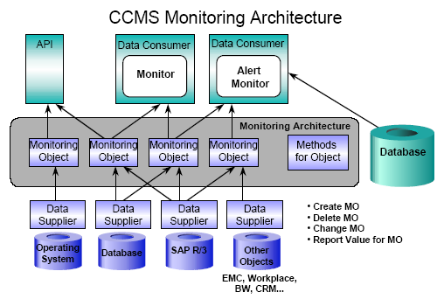
SAP’s Performance & Capacity Management Tools
Application Performance Management Tools
  The SAP solution includes a full set of application performance management tools. The Computer Center Management System (CCMS), an integral part of SAP applications, provides the most powerful tools available for ongoing operations, monitoring, administration and problem management. CCMS is used in system monitoring, operations and open interfaces.
    CCMS functions cover a wide spectrum, including:
        Performance monitoring
        Alert monitors
        Performance statistics
        Response times of dialogs
        Number of dialog steps per hour
        CPU utilization and load factors
        System management
        Load distribution and balancing
        Background processing
        Data backup and recovery
        Job scheduling
        Processing control
        Job monitoring
        Job class differentiation
        Response / reaction to external events
        Starting and controlling external programs
        Reservation of processing resources for maximum-priority jobs.

Slide 6
…..SAP’s Performance & Capacity Management Continued
  In terms of open interfaces, CCMS also provides various interfaces for use in organizations with a diversity of network services and third-party applications. This again emphasizes SAP’s architectural strength in meeting the demands of organizations of all sizes.
  CCMS provides open interfaces to system management tools like HP OpenView and Tivoli.
  All CCMS interfaces for system monitoring, system control and handling of alarm situations by external management tools are based on the SNMP (Simple Network Management Protocol) standard. These interfaces are two-way, allowing true interactive access.
    For example,
      CCMS can also use service interfaces to start and monitor external services, like the scheduling of jobs in an MVS environment or the execution of backups by outside tools. The CCMS interfaces permit seamless, flexible and efficient integration of third-party products.

Slide 7
Systems Management Recommendations…..
IT systems management strategy
  Evaluate use of applications management services, where it makes sense, including application development, application maintenance, portfolio management, conversions, application architecture and integration, package integration, legacy application extension and renewal, e-business application development and evolution, and user support.
  Evaluate the use of strategic IT outsourcing, where it makes sense, to allow Katz to focus on core competencies and strategic business goals. Offloading all or part of the operation of IT systems could free Katz from the cost of keeping up with rapidly changing technology, constant retraining and recruitment in a marketplace where IT skills are in short supply. Consideration should be given to:
    Information Technology
    Data Center
    Managed Storage
    Network
    NetWorkStation
    Customer Service Center
    Mid-Range HW Services
    Transformational Services
Administrative processes and organizational structure
  Continuous improvement of IT processes & organization based on the systems management strategy while being responsive to dynamic business needs, i.e.. The Katz help desk strategy

Slide 8
…..Systems Management Recommendations continued
Continuous evaluation of systems performance
  Katz needs to continue to focus on maximizing systems availability by developing robust testing and performance management capabilities, with the addition of Merchandising & SCM applications

Slide 9

Help Desk best practices would be met by a process that integrates the Katz Help Desk with both operations & project support services
Katz Help Desk
Single point of contact
User Profiles
Trouble Ticketing logging
Seamless operations for users
Initial Problem Determination /
Suite
Resolution
Common Monitoring
Service Request Management
Tools
Legacy app Support
End User
Common Operating
(Customer)
System
Common Infrastructure
or
Steering Committee
IT Function
Desktop Services
Content
+
Standards
Applications
Support
Business
Infrastructure
Management
Mgmt.
Solution Centre Services by
IBM or Others
I. Deployment
II. User Support
Implementation of Technical
Supporting Technology for
Strategy
all End Users
Asset Management
Call dispatching
Change Management
Control of Technology and
Proactive Systems
Assets
Management
Metrics Management
Technology Availability and
IV. Management
Performance
III. Network Service
Second Level Functional &
Technical support
Break & Fix support
Project Exec (PE)
Delivery Project
Server Monitoring/ Admin. / Back-up /
Customer Satisfaction
Exec (DPE)
Restore
Technical Solution
Overall Service
Service Delivery
Vendor Management /
Architecture
Management
Change Coordination
(Level 3 support)
End to end problem ownership
Change Orders
Service Reporting

Slide 10

Help Desk…..
Katz Support Requirements
  The existing Katz help desk strategy when executed will provide the initial receipt, routing, and tracking, of user support requests. The Katz service representatives will open a internal ticket and solve the problem or forward the service request, with additional information, to a SAP Support Center with a severity code.
SAP Support Overview
  SAP Active Global Support ensures that SAP solutions deliver maximum satisfaction and performance throughout its entire lifecycle. SAP’s Active Global Support organization consists of 4 key areas: product support, key account services, mission critical support, and primary support. The consultants in these key areas work together in order to “own” the customer issues and to ensure “one-stop dispatching” of issues to the correct areas of expertise.
IBM Customer Service Center Overview
  Based on a Single Point of Contact (SPOC) concept that provides problem resolution, including identifying the source of the problem; call management, including usage assistance, hardware/software/service coordination; dispatching/arranging on-site support as required for problem diagnosis and/or resolution; trend analysis, and providing monthly management and usage reports.

Slide 11
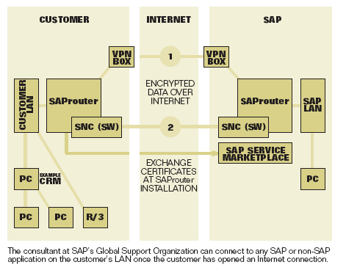
…..Help Desk Continued
SAP Remote Support Connection Alternatives
SAP offers two platforms for establishing remote support connections via the Internet.
The platforms are based on SNC-enabled SAP routers or virtual private networks, are cheaper and more flexible than leased lines, and they provide the high level of security that Internet-based communications demand.
They also enable highly effective troubleshooting tools.
Delete Slide??

Slide 12
Backup & Recovery Best Practices
Continuity and Recovery combines business and technological expertise to help keep businesses running. The best businesses sift through the layers of complexity in their business and IT infrastructures to provide a fail-safe continuity and implementation plans to provide information they deem critical. Continuity and Recovery practices includes three focus areas:
  Recovery Support. Katz must address protecting and recovering critical technology and data in multi-vendor environments, multi-vendor technology, IBM technology, networks and workplace.
  Recovery Services. Consideration for services, where it makes sense, with the technical expertise to develop; a recoverability assessment, recovery strategy definition, recovery plan development, recovery process and procedures design, continuity and security services for e-business, enterprise resource planning continuity, call center continuity, application continuity, risk management analysis and crisis management.
  Managed Continuity Services. Consideration of services, where it makes sense, for design, management and operation of business continuity and IT recovery programs. The program should provide a total solution that covers all of Katz business processes; a continuity service that fully reflects changes in corporate-wide business strategy; and management, of the end-to-end process of a corporate continuity program.

Slide 13
SAP’s Backup & Recovery Capabilities…..
Transaction Recovery
  Transaction recovery capabilities, including rollback (not saving incomplete transactions) and database recovery, are provided in the event of system interruptions. In order to ensure the consistency of the data, an update must be carried out in full or not at all. This is referred to as a rollback requirement. If a runtime error occurs during the update, all of the critical database changes made as a result of the update must be reversed. With update bundling and the SAP lock system, the update system ensures that the data remains consistent. The following steps are taken to maintain the consistency of the system:
    All updates already made are reversed
    The user receives an express mail indicating that the update was unsuccessful.
    The locks are released and a system entry is made in the system log.

Slide 14
…..SAP’s Backup & Recovery Capabilities
Disaster Recovery
  SAP supports disaster recovery services through close partnerships with certified hardware and software partners. A disaster is a situation in which critical components in the SAP environment become unavailable so that service cannot be resumed in a short period (less than a day as a general rule). A typical situation would be destruction of the hardware due to fire.
  Protecting SAP application host running enqueue and message services can be achieved by having a standby system available (at a remote site) that can be started up in the event of a disaster. If a standby system, which could also be another application server that has been reconfigured, is started to provide the critical SAP services, all other application servers have to be restarted.
  To protect the database, the entire database can be replicated with a method provided by the various database vendors. This approach is known as "Hot Site Backup" or "Standby Database." This means that the functionality to achieve replication is built into the database service instead of having to be coded by the client applications. These products follow the concept of "replication transparency": Oracle Standby Database, Informix HADR, Replicated Standby Database for IBM DB2 UDB on Windows/Unix/iSeries/zSeries and Microsoft SQL Server Standby Database. SAP supports these standby database solutions from SAP certified partners but may require additional licensing. SAP also works with hardware partners like EMC to support disaster recovery solutions like EMC SRDF and TimeFinder.

Slide 15
Backup & Recovery Recommendations
IT continuity and recovery strategy
  Evaluate use of business continuity and recovery services, where it makes sense, to assure that the business and technological expertise is available to help keep Katz running. Services could include recovery services, consulting services or managed continuity services for:
    Protecting and recovering critical technology and data
    Multi-vendor technology
    Networks and workplace
    Recovery Assessment
    Recovery strategy definition
    Recovery plan development
    Recovery process and procedures design
    Continuity and security services for e-business
    Enterprise resource planning continuity
    Call center continuity
    Application continuity
    Risk management analysis
    Crisis management.

Slide 16
Network Design & Network Services Best Practices
Effective management of circuit information to decrease costs and increase support effectiveness.
A network inventory management process to make technical support more effective.
Valid network planning with network diagrams to facilitate troubleshooting and to make future capacity and design planning efficient.
A network management processes to make forecasting, trending, and troubleshooting problems easily and decrease the cost of network downtime.
Alignment of IT strategy and business unit strategy to minimize network infrastructure compromises with potentially poor network design.
Integrated support and SLA processes will improve customer service levels and decrease resolution time.
Effective remote access design will decrease cost for support and maintenance.
Reviewing network infrastructure design will allow for validation of network architectures.

Slide 17
SAP’s Network Design & Network Services Capabilities…..
Secure Network Communication
  SAP offers a range of security mechanisms and services to assure secure transactions, to meet the highest demands for data integrity, protection, and confidentiality; and to support authentication, authorization, and secure information exchange.
  Encryption features ensure that information exchanged among users remains private. Support for HTTPS, the secure variant of HTTP, is included. Plus, a secure network communications feature uses external security solutions to protect communications links among the distributed components of the SAP platform.
  Secure store and forward mechanisms can take advantage of external security solutions to protect data in the SAP environment. Digital signatures offer non-repudiation, while digital envelopes wrap SAP data and documents in secure formats before they are stored or transmitted.
  Finally, the security audit log records events such as logon attempts and transaction starts, while the Audit Info System offers a summary of reports that provide key security information.

Slide 18
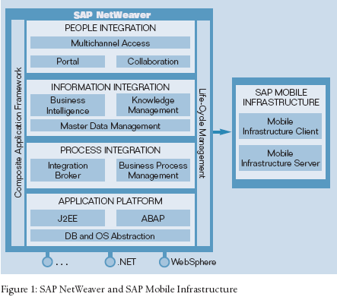
….. SAP’s Network Design & Network Services Capabilities continued
There are a number of options available as Katz considers how to operationalize the SAP environment. The traditional model of hosting and operating the SAP solution "in-house" is one that many customers still pursue. However, many customers are now considering and adopting a solution that sees the infrastructure (servers, software, etc.) and its support (data centre and network operations, application management, etc.) being managed as an outsourced solution. This allows customers to focus on their primary business objectives while the outsourcer focuses on the management and operation of SAP (their competency). SAP’s partner, IBM, offers many different solutions to the hosting and management of SAP solutions through their IBM Global Services business
Hardware and Network sizing has been performed by IBM SAP certified consultants. For more information, please refer to ……………..
Change Graphic?
Eliminate Bullitt?

Slide 19
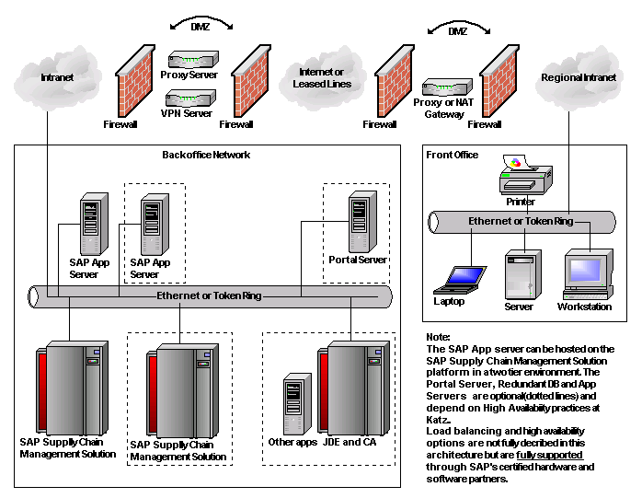
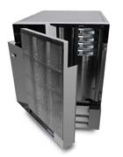




SAP’s Proposed High Level Technical Architecture
Tivoli
Sys.MgmTBD
Devt.
Server
Devt.
App
Server
VPN,
ADSL, Dial-up
ISDN
Satellite
Stores
STORE LAN
RF
Device
POS
Nexxsys
Store Portals

Slide 20
Network Design & Network Services recommendations
Planning, implementation, and support for multi-vendor networking solutions will need to be undertaken by Katz. New Merchandising & SCM applications will drive the requirements for robust solution. An assessment and strategy, complex network architecture, logical and physical design; implementation and network deployments; and ongoing network management will need to be performed by Katz or other services vendors. Katz will need to focus on three areas:
  Network Planning. This includes Network Assessments, Network Strategy, Creating a Network Architecture and Providing a Network Conceptual Design (reference SAP Proposed High Level Technical Architecture, page 19)
  Network Integration and Deployment Multi-vendor capabilities that include detailed network design, implementation (e.g., plan, install, configure, customize, test, tune, stage and deploy), cabling, wireless e-business, fiber transport services, project management and rapid network deployment. Analysis of existing network, protocols, wiring configurations and cabling standards to identify system interoperability and connectivity requirements. Plan, design and deploy reliable network business solutions.
  Network Management. Includes perform/run aspects of the operation of a WAN or LAN network and its components. These components can include network devices (e.g., routers, switches, hubs), server devices (e.g., host computers, server systems), security devices (e.g., firewalls, remote access equipment, hardware security devices) and desktop devices like personal computers, network bandwidth and wireless networking devices.

Slide 21
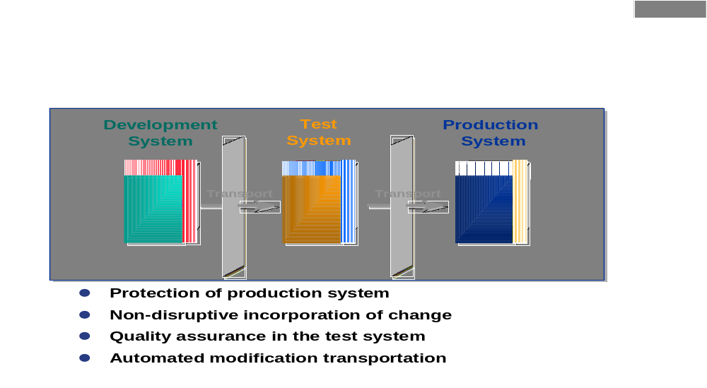
Support, Development, Test, and Production Environment Design…
The infrastructure that SAP recommends to support effective change management is a three-system landscape with separate development, test and production systems.

Slide 22
…..Support, Development, Test, and Production Environment Design Continued
It is within the development system that any changes necessary to configure the application are performed. Objects that are the subject of change are allocated to a change requests. Any object that is allocated is checked out thus eliminating parallel change to an individual object. When all changes are complete in development, the change request is released for transport to the test system.
Within the test system, full system testing is performed. If the changes test successfully, they are transported to production. If the changes do not test successfully, appropriate changes are made in development and the change is re-migrated to the test system. Changes are only introduced to production once they have been successfully tested in the test system. Any changes that are introduced into production are first tested in a test partition before being introduced to an active production partition.
If changes have to be backed out of production, this is done with a correcting change request that effectively overwrites the unwanted change with the prior version.
In order to deploy an effective test environment, most SAP customers deploy a fully copy of production data. At suitable intervals test data can be refreshed by restoring a production backup. Alternatively, one can also perform a test refresh with a production mirror split that is subsequently merged with the test disks.

Slide 23
Back up Stuff………….

Slide 24
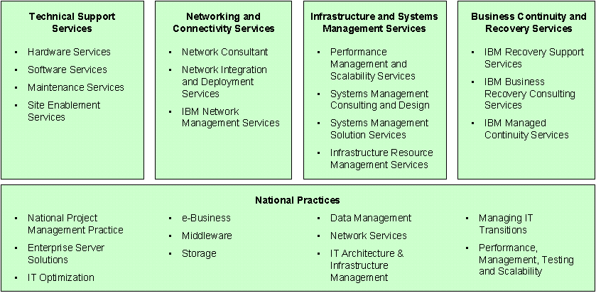
IBM Integrated Technology Services (ITS)
Integrated Technology Services focuses on changing customer business needs that call for redesign and implementation of new systems, access to help-desk and technical-support services, performance monitoring in the event of an earthquake, floor or other natural disaster, and businesses recovery. In order to drive clarity and focus, ITS grouped such capabilities into four categories comprised of 14 offerings.

Slide 25
…………..IBM Integrated Technology Services (ITS) (to be edited and reduced)
Technical Support Services Technical Support Services includes hardware and software support services; hardware and software planning, design, installation, relocation and migration services; site services for IT facilities; and power protection services to address electrical and mechanical environment protection needs. The Technical Support Services practice includes four focus areas:
Hardware Services. Provides a comprehensive set of skills and capabilities to assist with a full range of both OEM and IBM Hardware Product Support needs. IBM Hardware Services are applicable across a wide spectrum of opportunities ranging from relatively simple, single-server environments to very complex, multiserver, multi-vendor environments. These services include Hardware Planning, Design, Installations, Relocations, Moves, Additions, Changes, Upgrades, Equipment Modifications and Operational Support services.
Software Services. Provides a comprehensive set of capabilities to assist with a full range of software support for the entire IBM server family, as well as all Storage Systems products, SAN and SWG products. The services cover all operating systems - including OS/390 (“z” series), VSE, AS/400 (“i” series), AIX (“p” Series”), UNIX, Windows (“z” series) and Linux - and subsystems and middleware - such as DB2, CICS, IMS, UDB, MQSeries, WebSphere, WebSphere Commerce Suite, TCPIP, security, TSM and HACMP. The services range from one-time offerings to multiyear, ongoing support offerings including staff augmentation or out tasking of clients' selected operational and system functions.
Maintenance Services. Provides warranty services and preventive service for systems that are likely to need repair soon for hardware maintenance with a standard service level. These services includes predictive services by monitoring hardware error activity and dispatching service personnel when error thresholds are exceeded to prevent potential failure.
Site Enablement Services. Provides a comprehensive set of capabilities to assist customers with changes to their physical IT infrastructure. It also provides Planning, Design, Implementation and Power Protection Services, focused on minimizing the environmental causes to business disruption. This includes basic site preparation through total solution development, design and implementation of data centers, e-business cyber centers and intelligent buildings.

Slide 26
…………..IBM Integrated Technology Services (ITS) (to be edited and reduced)
Networking and Connectivity Services This service assists customers in planning, implementing and supporting networking solutions, whether involving IBM or other vendor's technologies, including Cisco, Nortel, 3Com, etc. It also provides assessment and strategy consulting; complex network architecture and high-level design; logical and physical design; implementation and network deployments; and ongoing network management services. The Networking and Connectivity Services practice includes three focus areas:
Network Consulting. Provides a collection of business-oriented capabilities that include network assessment, strategy, architecture and conceptual design and uses a proven consulting methodology to resolve complex business issues. This includes Network Assessments, Network Strategy, Creating a Network Architecture and Providing a Network Conceptual Design.
Network Integration and Deployment Services. Provides a set of multi-vendor capabilities that include detailed network design, implementation (e.g., plan, install, configure, customize, test, tune, stage and deploy), cabling, wireless e-business, fiber transport services, project management and rapid network deployment. Professionals in this area analyze client's existing network, protocols, wiring configurations and cabling standards to identify system interoperability and connectivity requirements and then plan, design and deploy reliable network business solutions.
IBM Network Management Services. Provides perform/run aspects of the operation of a WAN or LAN network and its components in a customer's environment. These components can include network devices (e.g., routers, switches, hubs), server devices (e.g., host computers, server systems), security devices (e.g., firewalls, remote access equipment, hardware security devices) and desktop devices like personal computers, network bandwidth and wireless networking devices.

Slide 27
…………..IBM Integrated Technology Services (ITS) (to be edited and reduced)
Infrastructure and Systems Management Services This service takes an enterprise-wide, consultative approach to help customers manage their host-centric, distributed, desktop and network environments. Services encompass the entire life cycle, from assessment, strategy and design to implementation and operational services. The Infrastructure and Systems Management Services practice includes for focus areas:
Performance Management and Scalability Services. Focuses on maximizing customer systems availability with a particular focus towards e-business, given the criticality and visibility of available, reliable, secure and responsive systems is even more paramount in this domain than ever before. This offering couples the focus on High Availability Services with Testing and Performance Management Services to provide a robust set of capabilities.
Systems Management Consulting and Design. Helps customers overcome the challenges in managing and operating enterprise information systems. These services also assist in defining long-term IT systems management strategy, designing administrative processes and selecting tools to manage systems and creating an organizational structure that enables continuous evaluation of systems performance against dynamic business needs.
Systems Management Solution Services. Comprises Tivoli Services and services to other highly effective systems management software products, such as those offered by BMC, Computer Associates (CA) and Candle, coupled with systems management services, to satisfy customer's solution needs. The offerings include products and services that help customers develop and deploy systems management solutions quickly, efficiently and incrementally.
Infrastructure Resource Management Services. Provides customers with a complete solution for managing and supporting the technology infrastructure. Also provides the expertise to manage and support increasingly complex infrastructures through a combination of world-class skills, processes and tools. The offering elements include Consulting, Procurement, Configuration (PDP), Rollouts / Deployments, Move / Add / Change, Tracking and Reporting, Wall-to-Wall Inventory, Disposition and Remote Infrastructure Support.

Slide 28
…………..IBM Integrated Technology Services (ITS) (to be edited and reduced)
Business Continuity and Recovery Services Business Continuity and Recovery Services combines business and technological expertise to help keep customers' businesses running. The service helps customers sift through the layers of complexity in their business and IT infrastructures to provide a fail-safe continuity and implementation plan to keep their business fueled with the information they deem critical. Services include recovery services, consulting services and managed continuity services. The Business Continuity and Recovery Services practice includes three focus areas:
IBM Recovery Support Services. Addresses protecting and recovering critical technology and data in multi-vendor environments. The services include recovery options for multi-vendor technology, IBM technology, networks and workplace.
IBM Business Recovery Consulting Services. Provides business and technical expertise to assist customers with IT Recovery Assessment and Planning Services, Critical Business Process Continuity Services and Business Interruption Impact and Risk Management Services. Services include recoverability assessment, recovery strategy definition, recovery plan development, recovery process and procedures design, continuity and security services for e-business, enterprise resource planning continuity, call center continuity, application continuity, risk management analysis and crisis management.
IBM Managed Continuity Services. Helps customers focus on their core business while IBM designs, manages and operates their business continuity and IT recovery program. Key elements include ongoing program management and interlocking business issues with IT challenges. We provide a comprehensive business continuity program, designed and managed for customers, that aligns with their business objectives. This program provides a total solution that covers all of their business processes; a continuity service that fully reflects changes in corporate-wide business strategy; and management, on their behalf, of the end-to-end process of a corporate continuity program.

Slide 29
…………..IBM Integrated Technology Services (ITS) (to be edited and reduced)
In addition to these four focus areas, there are also eleven ITS National Practices. These ITS National Practices focus on enabling the solutions and capabilities that drive ITS revenue and profit. The eleven practices include:
National Project Management Practice
Systems Migrations / Enterprise Server Solutions
IT Optimization
e-Business
Middleware (e.g., Websphere and MQSeries)
Storage
Data Management
Network Services
IT Architecture & Infrastructure Management
Managing IT Transitions
Performance, Management, Testing, and Scalability

Slide 30
IBM Strategic Outsourcing (to be edited and reduced)
Managing business processes and technology operations drain precious resources and time that could be better focused on a company's core competencies and strategic business goals. For this reason, many companies retain outside firms to own and operate all or part of their IT infrastructure. IT Outsourcing Services (referred to as Strategic Outsourcing or “SO”) lets a business offload the operation of its IT systems and processes so it can focus on what it does best, whether that's manufacturing, banking, or running a government agency. IBM SO works with customers to evaluate their business objectives and identify which IT operations can be outsourced for competitive advantage, freeing them from the cost of keeping up with rapidly changing technology, constant retraining and recruitment in a marketplace where IT skills are in short supply. We are increasingly combining traditional Strategic Outsourcing deals with major Business Consulting Services consulting engagements -- a winning combination that delivers high value to customers and big signings to IBM.
Information Technology Outsourcing. Within the last few years, outsourcing has evolved from a tactical, cost-cutting maneuver for offloading routine tasks and acquiring temporary manpower to a strategic element in business transformation. At the center of this transformation is the need to convert traditional business practices into an e-business model to reach the millions of customers, suppliers—even competitors—on the Internet. IBM furnishes a full range of information technology services encompassing entire data centers or discrete systems, desktop systems, as well as crucial management functions and vital support processes.
Data Center Outsourcing Services. Provides management and support for IT and business operations. Outsourcing contracts range from high-end server (host) operations and midrange services to distributed IT services. Data Center Outsourcing Services form strategic partnerships that enable companies to focus on their core businesses since the quality IT services they need to grow and prosper are provided by IBM.
Managed Storage Services. Allows clients to purchase storage capacity and management services on a usage basis. By teaming with IBM for storage management, companies are free to concentrate on their primary business goals with the assurance that their unique data performance and availability requirements will be met. Both on-site and remote options are available. Regardless of where the data is housed, IBM Managed Storage Services offers consulting, planning and implementation services that are optimized to meet a client's unique requirements. The two options are:
Network Outsourcing Services. Provides a managed and integrated network solution for businesses that do not want to own or run their network or network resources. With a fully-managed network, companies can use skilled networking professionals, leverage emerging network technologies and transfer their technology risk, while focusing on their core business. Together with our strategic partners, we can quickly deliver a range of managed network solutions—from IP convergence, enhanced security and virtual private networks (VPNs), to distributed, edge-of-network server and storage computing environments and other next-generation network applications.
NetWorkStation (NWS) Management Services. Provides an approach to the desktop environment that incorporates an integrated set of management tools and processes to enable central control and management of the desktop environment. NetWorkStation Management (NWS) is a comprehensive and customizable suite of systems management services developed to integrate and manage multi-vendor, multi-platform distributed systems and networks.
Customer Service Center. Based on a Single Point of Contact (SPOC) concept that provides problem resolution, including identifying the source of the problem; call management, including usage assistance, hardware/software/service coordination; dispatching/arranging on-site support as required for problem diagnosis and/or resolution; trend analysis, and providing monthly management and usage reports
Mid-Range Services. Allows an organization to have their mainframe or client/server operations managed by IBM. Our consultants start with a flexible base scope of work and help you identify areas of need and implement efforts to streamline operations. As your requirements are identified, this base scope is adjusted to ensure your IT operations meet your business strategies.
Mid-Range Services Express (MRX). Provides a set of cost-effective, packaged services designed to help small and medium businesses (SMBs) run their AS/400(s). MRX/400 allows companies to supplement their in-house IT with IBM services, eliminating the need to hire and train additional support staff or divert internal IT resources from core business projects. With this service, customers gain fast access to IBM's existing AS/400 operational infrastructure—the skills, facilities, and resources necessary to operate, house and support an AS/400.
Transformational Outsourcing. Provides a platform for growth that takes into account both a customer's present and future requirements. It is a systematic approach to introduce and sell a "run/manage" value proposition to customers while IBM is delivering project-based services. The focus is on applications and IT infrastructure application and run.

Slide 31
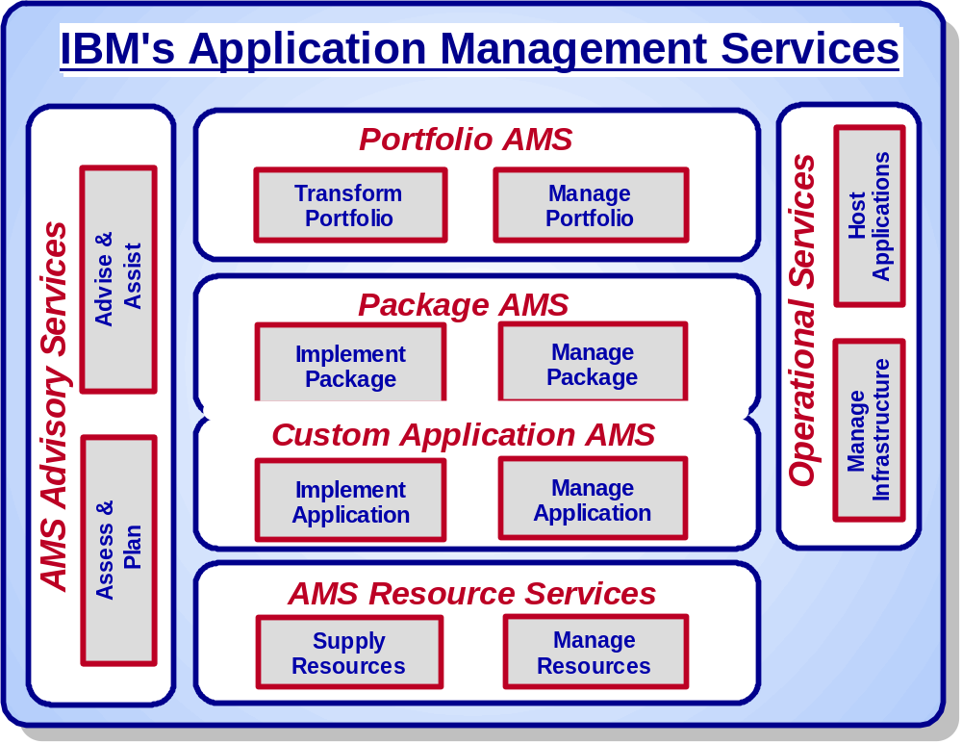
IBM can propose the appropriate Application Management Services offerings. (to be edited)
Application Managed Services line of business is a complete set of application-related services that includes application development, application maintenance, portfolio management, conversions, application architecture and integration, package integration, legacy application extension and renewal, e-business application development and evolution, and user support. The following graphic illustrates the categories of the AMS global offerings.
Business Consulting Services

Slide 32
Benefits of Application Management Services - SAP
Operations and IT Staff Efficiencies
  Experts on Demand
    versus experts on staff
    33,000 AMS staff, 2800 in Canada
    Over 5000 global SAP implementation and optimization resources
  Flexible down banding
    as environment maturity increases
  Better quality cost balance
    career, training, mobility, measurements and rewards
  Access to low cost off-shore resources
  Reduce the dependence on contractors
Process Efficiencies
  Compressed time-to-market for new services and reduced time to deploy new functionality (RAC)
  World class methods, and continuous investment in processes.
  World class tools and support infrastructure
  Investments in Maturity to kill systemic problems (e.g. SEI CMM)
Infrastructure, Support and Facilities Efficiencies
  Reduced effort required to evaluate, procure, maintain, and upgrade rapidly depreciating technology investments
  Economies of scale on hardware, software and facilities can be accrued, including sharing of hardware such as high availability storage and networking resources across applications & projects
  Direct vendor relationships enables client offloading of vendor relationship management
Financing Efficiencies
  Predictable monthly fee creates predictable cash flow and elimination of upfront cash outlays
  Reduction in upfront capital expenditures for projects, hardware, software and facilities
  Increased capacity as needed and pay according to negotiated arrangements

Slide 33
IBM Application Development and Maintenance (ADM) Benchmark provides unique insight into systems performance
Benchmarking is a powerful tool that helps organizations improve performance.
Business Consulting Services
First Benchmark focusing on Application Development and Maintenance organizations.
A comparative assessment to determine:
  The Performance levels achieved by ADM organizations compared to that of other organizations in the same industry and in the same geography
  The level of Practices to deliver that performance with identification of the organization’s strengths and weaknesses
  Linkages between Practice and Performance that enable clients to identify the improvement opportunities that will bring the best return on investments
An analysis of 66 ADM Practice and Performance indicators in 8 domains aligned with the CMMI framework categories:
Organization & Culture, Skills, Process Management, Project Management, Quality Management – Support, Engineering, Technology and Innovation, Measurements.

Slide 34








BCS AMS Big Play Summary
Description of Solutions and Offerings
IBM References/Experience
Please ensure the Client Manager is contacted
before using any client names as references.
Service Category | Service sub-category | Offerings
Custom AMS | For Traditional Applications | AMS for Traditional Applications Legacy Transformation
 | For e-business Applications | AMS for e-business Applications e-AMS
Package AMS |  | ERP Benchmarking AMS for SAP AMS for PeopleSoft AMS for JD Edwards Etc.
Annuity AD |  | Accelerated AD Services (RAC)
Portfolio AMS |  | AMS Benchmarking AMS for Portfolios of Applications Application Portfolio Management
Other | ASP / Utility like Services | JD Edwards ASP Genelco ASP Siebel ASP Lotus Notes ASP netCallCentre
Where To Get Additional Information / Who To Call
Contacts
Your Local BCS Principal FIRST
Tom Langendorf, Sector Executive
Rick Wilson, Financial Services, 416-956-7990
Mark Bell, Public Sector, 416-490-4150
Dave Mahr, Industrial / Distribution / Communications, 416-774-1314
Gord Ball, Mid-Market Executive, 905-316-1302
Manoj Prajapat, Mid-Market, 905-316-4285

Slide 35
AMS and IBM’s broader portfolio capabilities
Total IBM Value Proposition
Hardware
Do you have capacity to
run a new/existing software package?
(server platform, storage, tape, etc…)
Do your users have the tools to leverage the
new SW? (PC’s, wireless devices, etc.)
Software
What database software is required
By the new software? Are you
Running systems management sw? Or
Require sw with email / workflow /
e-commerce capabilities? (Lotus,
Webshpere) Would moving to IBM
Software enable you to lower your
Total cost of maintaining your
applications?
BCS Consulting Services
Do you have a change management strategy?
Are your business processes best of breed?
Are your trading partner relationships
efficient?
Do you understand where you are benchmarked
against other companies within your industry
from an AD&M perspective?
Learning Services
Who will be educating your users to use
the new systems?
Do you have corporate trainers?
AMS Big Play
Package or Custom
e-business
Have you considered valuable application
extensions to your base system? i.e:
Customer self service
HR Portals for employees
Wireless solutions
AMS
Do you have the skills internally to maintain
the new/existing applications? Could
resources be better utilized elsewhere? Do
you internally manage your website? (e-AMS)
Do you have specific issues around running a
package application? Do you have issues
around application development and
the speed with which you get your
applications and their business benefits
to market?
Hosting
Do you have a secure and stable
environment to house the new system?
Could the resources running/
maintaining your systems be better
utilized elsewhere? Do you require an
off site totalsolution for managing your
e-business or package application?
ITS
Does your network Infrastructure support the
expected throughput of the new system? Are
you comfortable your security procedures and
setup are protecting your business? Do you
have redundancy in place in case of lost data
or physical assets?
Align the benefits of your technology investment with their associated costs
through IBM Global Financing

Slide 36
IBM has created a series of Web Effectiveness offerings
Lack of
online presence
Web Launch
Webify your forms
Requirements Quickstart
Strategic Marketing Support
Web Operational Effectiveness
Web Metrics
Competitive Assessment
Usability Assessment
Web Assessment
Lack of online channel integration with other channels and service delivery
Missed Revenues
opportunities
SMB
Issues
Insignificant online
traffic volume
Lack of justification for web investments
Lack of
customer loyalty

Slide 37
IBM’s Unified Solution
Business Consulting Services
Content (Algoma)
Functional application management
SAP functional configuration
Bolt-on
Bolt-on
Bolt-on
SAP technical configuration (Basis)
Technical application management
Monitoring / reporting
Middleware
Database
Service Level Agreements
Help Desk/Call Mgmt
Server and operating system management
Infrastructure management
Network and firewall management
IBM Hosting Center
…By shifting the infrastructure management and capacity burden to IBM and leveraging our high-performance, scalable infrastructure and application management Services, Algoma will:
        Lower capital expenditures and management costs
        Speed application deployment and integration
        Avoid the risk of resource shortages
        Reduce deployment risk by expanding from an existing platform
        Gain access to comprehensive, scalable service and support capabilities

